Slide 1
Concurrency — Exercise 7
Locking 3

Slide 2
Problem 1
Rebuild your own class MyExecutor that gets passed instances of Runnable and has them executed by a self-managed thread-pool of fixed size.

Slide 3
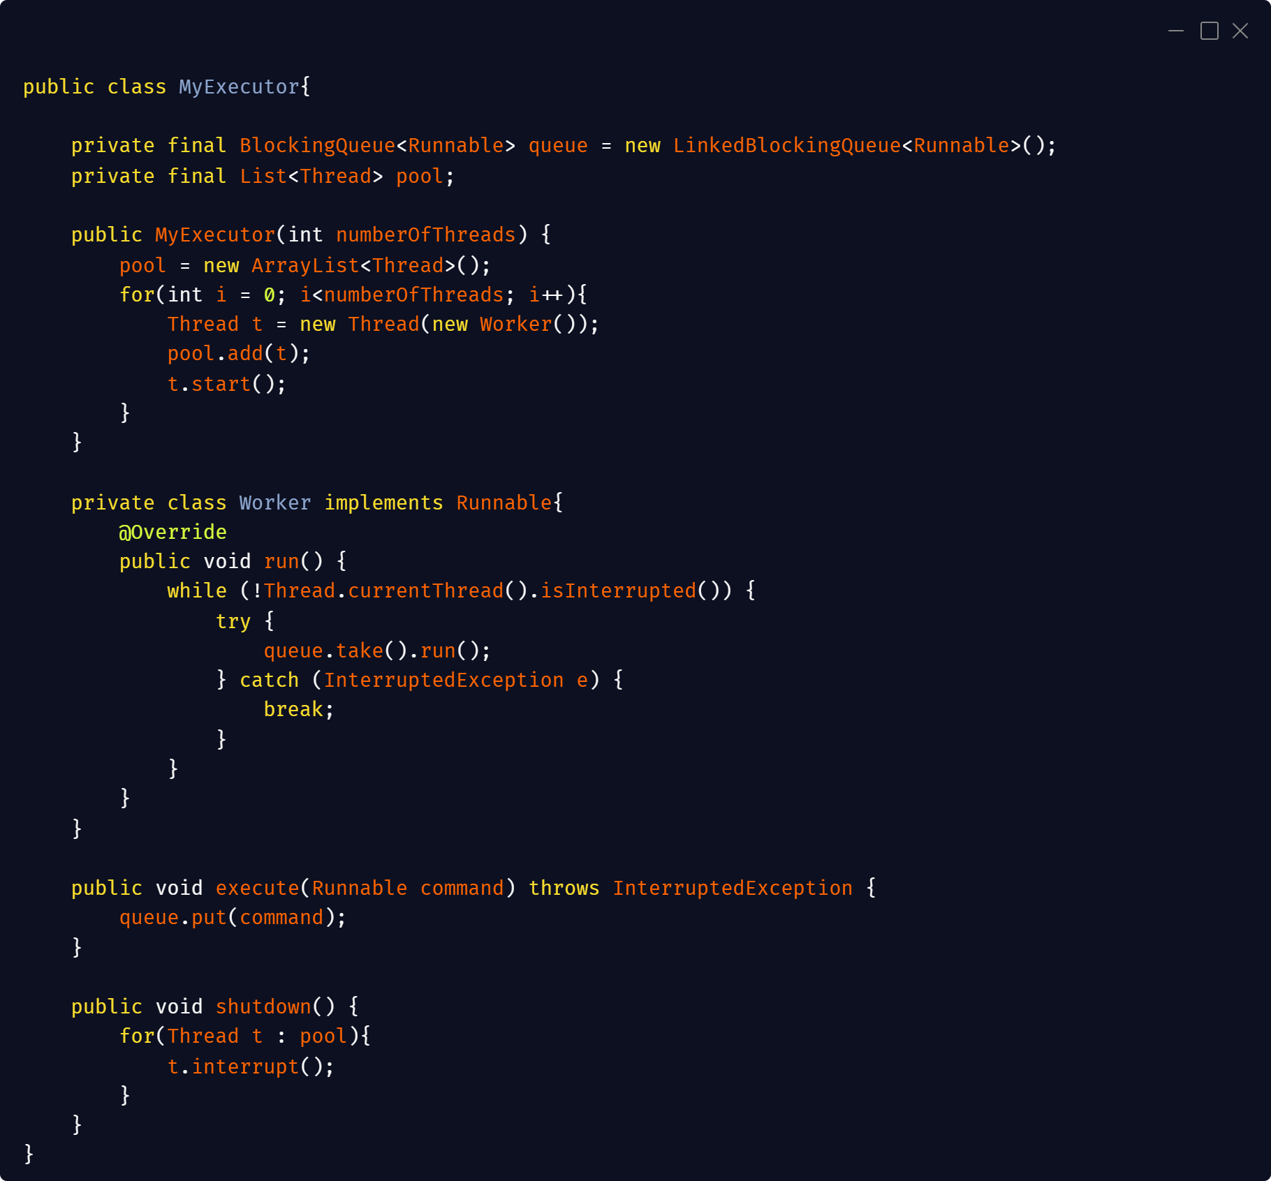

Slide 4
Problem 2
Extend your solution to problem 1 such that your executor can also get passed instances of Callable, and that it returns Future objects for these Callable objects.

Slide 5
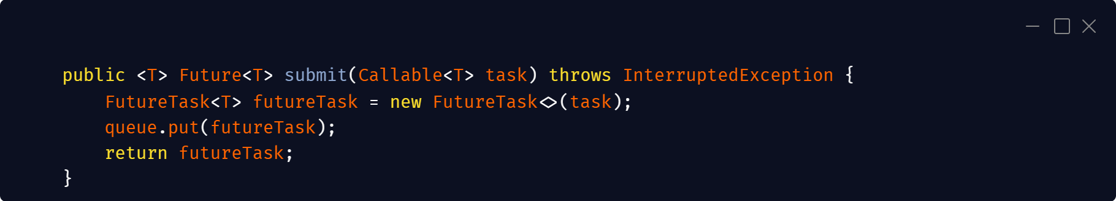

Slide 6
Problem 3
Using your own executor implementation, rebuild your own class MyCompletionService that manages the results of the previously submitted Callable instances in a queue as they are completed.

Slide 7
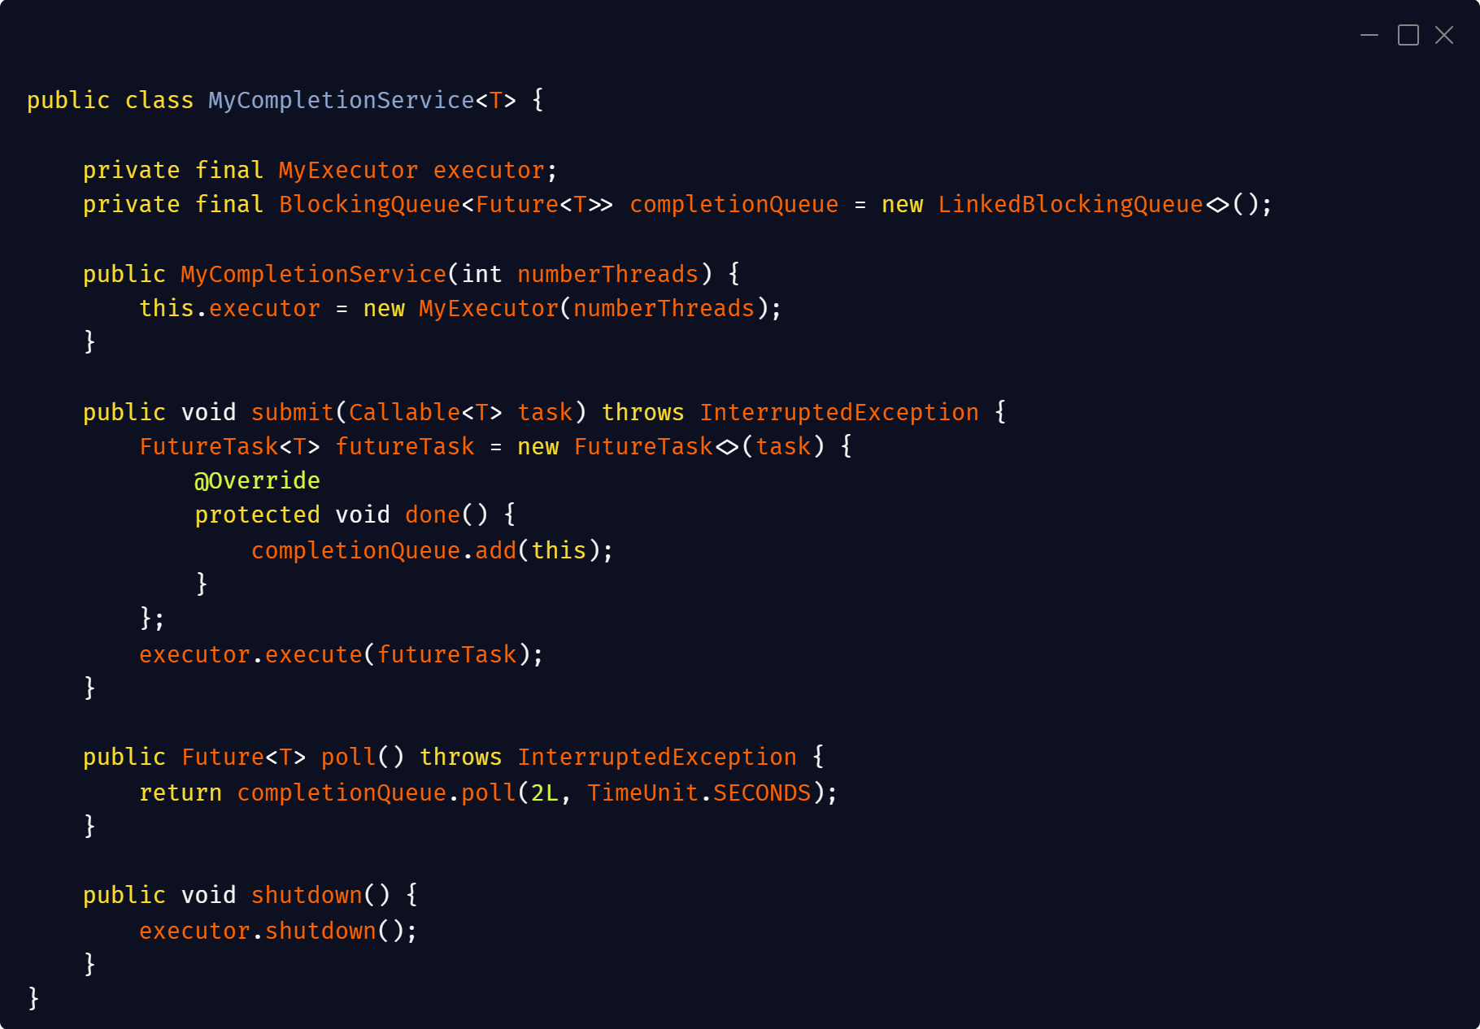

Slide 8
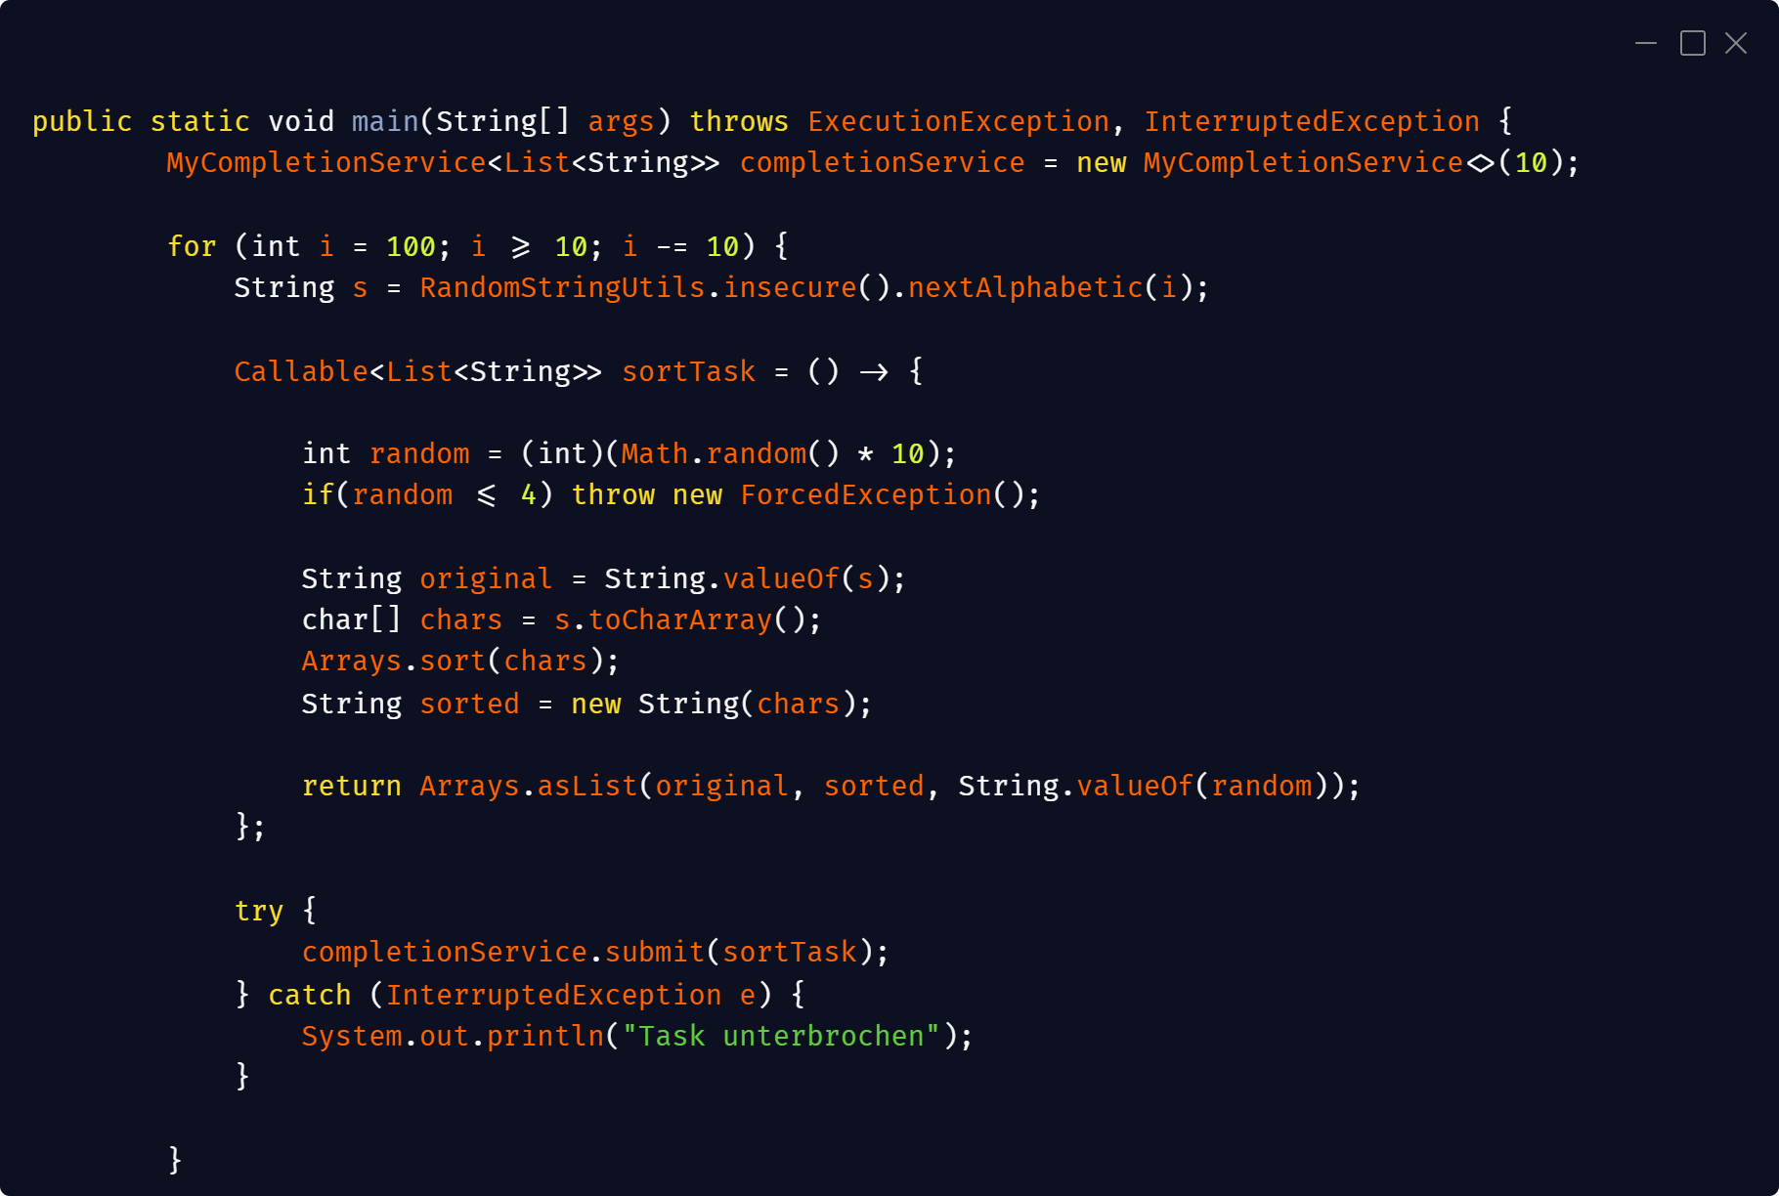

Slide 9
